Slide 1
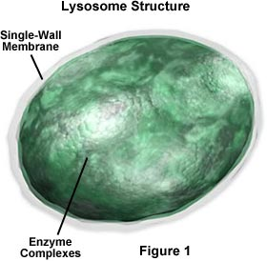
Lysosomes :
They are simple, one membrane bound sacs, filled with digestive enzymes.
These enzymes are made by RER.
Due to various metabolic activities going on in the cell, organic waste is generated.
The powerful enzymes are capable of digesting these wastes.
So lysosomes digest the waste.
Plant cells have very few lysosomes.
Because generally in most of the plants the waste is stored.

Slide 2




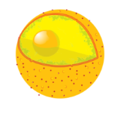
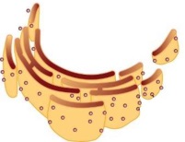

Functions of lysosomes :
As it is the digestive system of the cell, it protects the cell by destroying any foreign material like bacteria and viruses that invade the cell.

Slide 3
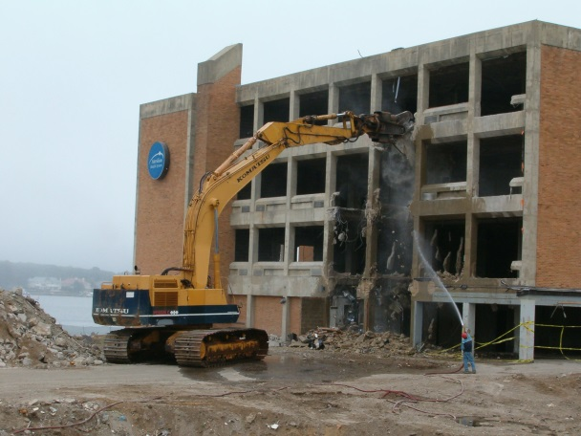
Functions of lysosomes :
They remove worn out cellular organelles and remove all organic debris.
Damaged
This process is called Autolysis.
So they are called as ‘Demolition Squads’.
Waste materials
Self digestion

Slide 4
Functions of lysosomes :
During the disturbance in cellular metabolism, for example, when the cell gets old or damaged, lysosomes burst and the enzymes digest their own cells.
Therefore lysosomes are also called as ‘Suicide Bags’.

Slide 5
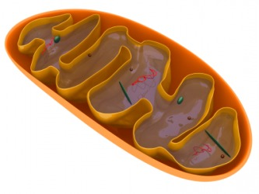
Mitochondria :
Inner membrane
It is a double membrane structure.
Cristae
The outer membrane is porous
while the inner membrane is deeply folded.
Ribosomes
The folds are called cristae.
They create a larger surface area for efficient functioning.
Outer membrane
DNA
The mitochondria have their own DNA and ribosomes.
Therefore they are capable of making some of their own protein.

Slide 6

Mitochondria :
Mitochondria oxidise carbohydrates and fats with the help of enzyme to release energy in the form of ATP
C
F
Enzymes
C
Break down

Slide 7
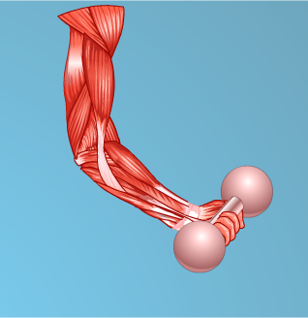
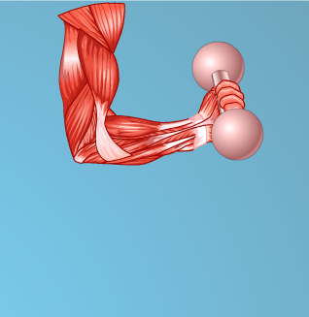
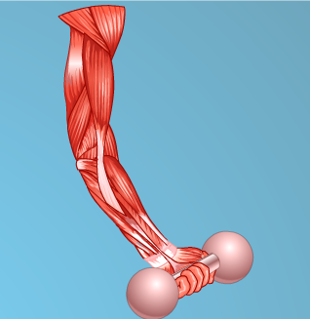
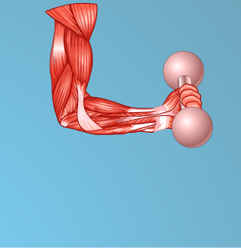
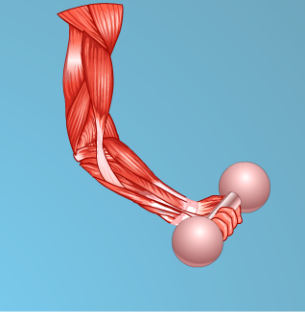

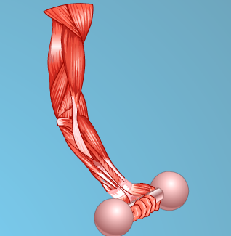
Functions of mitochondria :
Mitochondria produce energy in the form of ATP which is a energy currency of the cell.
Therefore mitochondria are called as the powerhouse of the cell.
Useable form of energy
The body uses this energy to synthesize chemical compounds
and to do mechanical work (movement of muscles,
Produce
production of heat,
conduction of nerve impulses, etc.)

